Slide 1
COOLING LOAD ESTIMATION OF THERMAL SCIENCE LABORATORY AND CAD-CAM LABORATORY OF MECHANICAL DEPARTMENT, IIT GUWAHATI
BY VISHAL MAURYA

Slide 2
DESIGN CONSIDERATIONS
Outdoor Design Condition:
at peak time, DBT= 89.9˚F(32˚C), 90% RH (for Guwahati)
Indoor Design Condition:
at peak time, DBT= 75˚F(24˚C), 50% RH

Slide 3
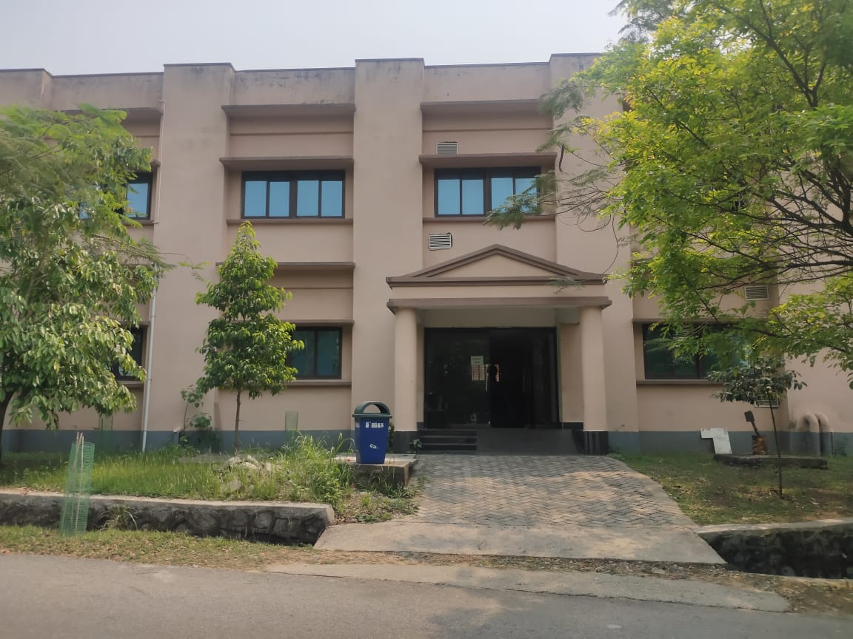
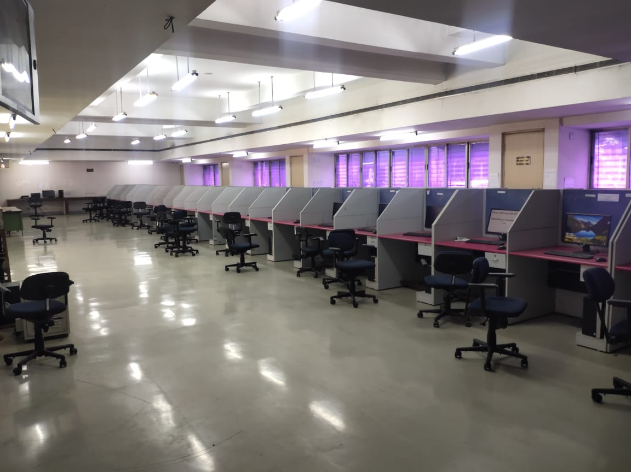
Glimpses of labs

Slide 4
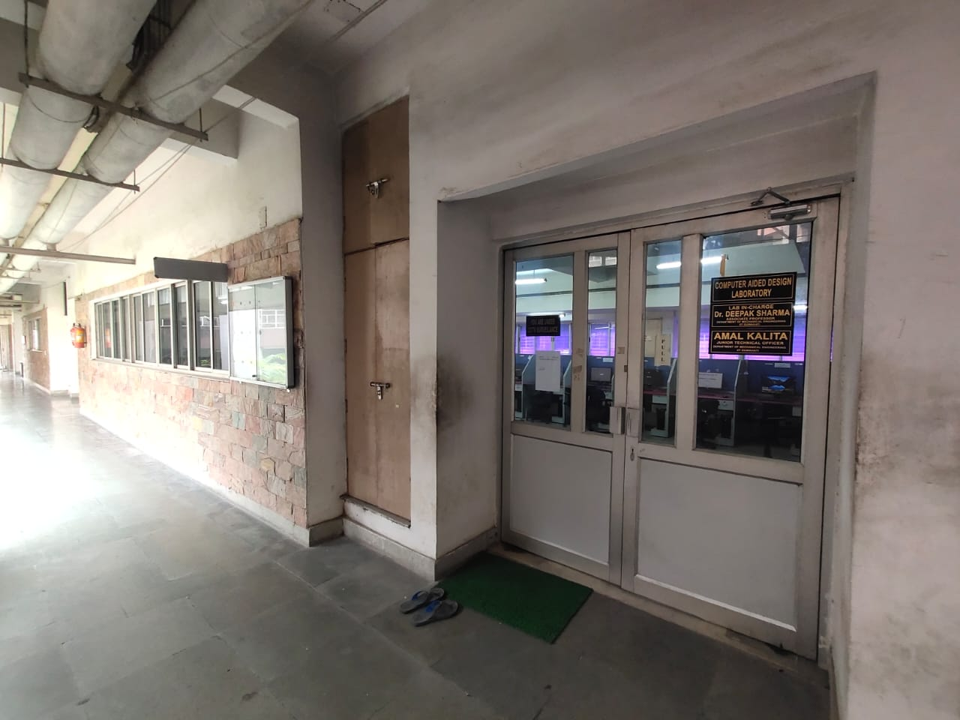
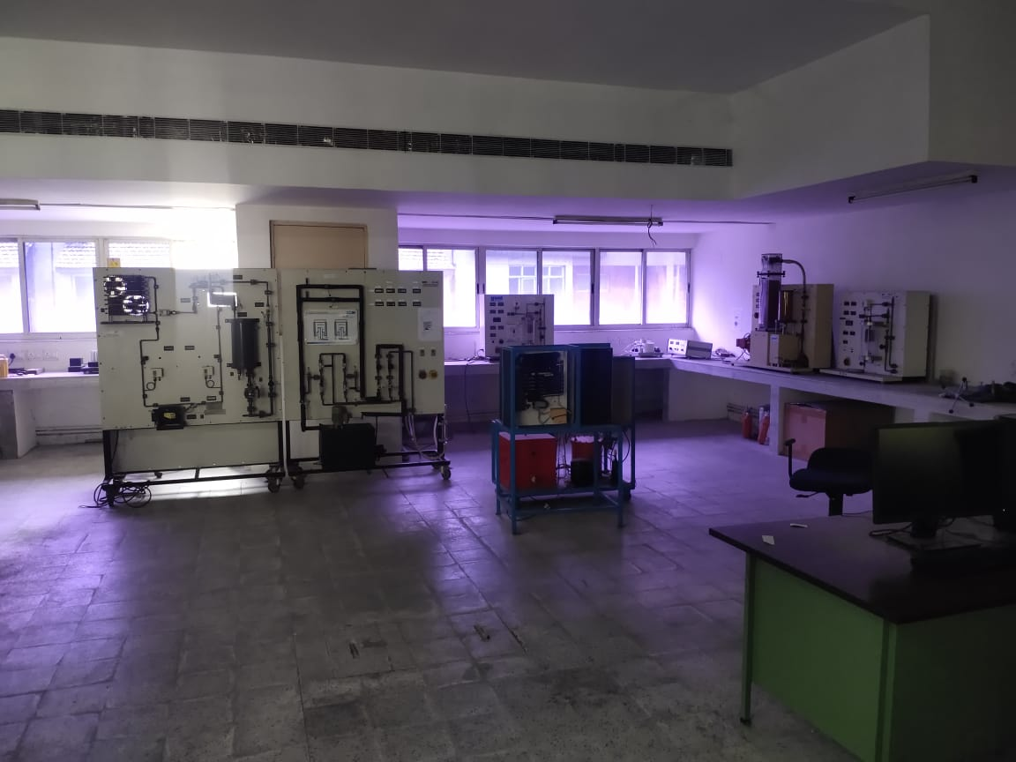
Glimpses of labs

Slide 5
CALCULATION OF CLTD CORRECTION
CLTD_{C} = [CLTD + (78 – TR) +(TM – 85)]
Where
TR= inside design temp= 75.2˚ F
Daily range= max DBT- min DBT
= 89.06-77.54 = 11.52 F (from Guwahati climate graph)
TM=Mean outdoor temp= Max outdoor temperature-(Daily range/2)
= 31.7-6.4/2= 28.5˚ C or 83.3˚ F
THERMO SCIENE AND TURBO MACHINERY LAB
CAD-CAM LAB
 | CLTD (˚F) | CLTDc (˚F)
North wall | 12 | 13.1
South wall | 13 | 16.1
 | CLTD (˚F) | CLTDc (˚F)
North wall | 12 | 13.1
South wall | 13 | 16.1

Slide 6
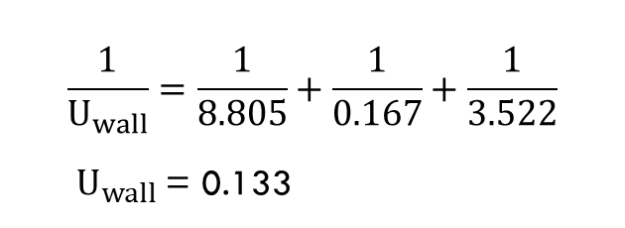
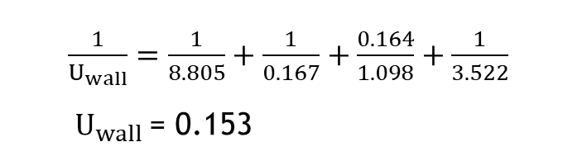
Calculation of Heat transfer co-coefficient
$$\frac{1}{U_{l}}=\frac{1}{h_{\begin{aligned}outside \\ air\end{aligned}}}+{\left(\frac{L}{K}\right)}_{concrete}+{\left(\frac{L}{K}\right)}_{brick}+\frac{1}{h_{\begin{aligned}concrete \\ air\end{aligned}}}+\frac{1}{h_{\begin{aligned}inside \\ air\end{aligned}}}$$
For north wall
Inside air
$$\frac{1}{U_{l}}=\frac{1}{ho}+{\left(\frac{L}{K}\right)}_{concrete}+\left(\frac{L}{K}\right)rock+\frac{1}{\begin{aligned}hi \\ \end{aligned}}$$
Concrete
1 feet
$\frac{1}{U_{wall}}=\frac{1}{8.805}+\frac{1}{0.167}+\frac{0.164}{1.098}+\frac{1}{3.522}$
${ U}_{wall}$= 0.153
Cinder rock brick
0.164 feet
Outside air
For south, east, west walls
$$\frac{1}{U_{wall}}=\frac{1}{ho}+{\left(\frac{L}{K}\right)}_{concrete}+\frac{1}{\begin{aligned}hi \\ \end{aligned}}$$
Inside air
Concrete
$$\frac{1}{U_{wall}}=\frac{1}{8.805}+\frac{1}{0.167}+\frac{1}{3.522}$$
$U_{wall}$= 0.133
1 feet
Outside air

Slide 7
Calculation of heat load through wall
Q= U×A× CLTDc
EXTERIOR WALL
THERMO SCIENE AND TERBO MACHINERY LAB
CAD-CAM LAB
 | Area | CLTDc (˚F) | U | Q
North wall | 2592 | 13.1 | 0.153 | 4821.6
South wall | 2688 | 16.1 | 0.133 | 4050.8
 | Area | CLTDc (˚F) | U | Q
North wall | 3676 | 13.1 | 0.153 | 7367.8
South wall | 3740 | 16.1 | 0.133 | 8008.4

Slide 8
INTERIOR WALL
Q=U*A*∆T
THERMO SCIENE AND TERBO MACHINERY LAB
 | A | ∆T | U | Q
WEST | 414 | 8.1 | 0.133 | 446.002
EAST | 414 | 8.1 | 0.133 | 446.002
CAD-CAM LAB
 | A | ∆T | U | Q
WEST | 414 | 8.1 | 0.133 | 446.002
EAST | 414 | 8.1 | 0.133 | 446.002

Slide 9
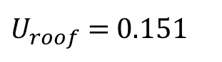
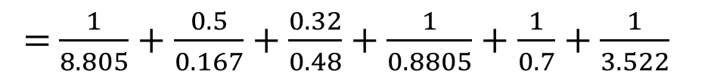
Calculation of heat load through Roof
CAD – CAM LABORATORY:
Roof is exposed to Thermal- science lab which is also air conditioned
Qroof = 0
THERMAL-SCIENCE LABORATORY:
Roof Tiles
4’’
$$\frac{1}{U_{roof}}=\frac{1}{h_{\begin{aligned}outside \\ air\end{aligned}}}+{\left(\frac{L}{K}\right)}_{concrete}+{\left(\frac{L}{K}\right)}_{roof tiles}+\frac{1}{h_{\begin{aligned}concrete \\ air\end{aligned}}}+\frac{1}{h_{\begin{aligned}tiles \\ air\end{aligned}}}\frac{1}{h_{\begin{aligned}inside \\ air\end{aligned}}}$$
Air gap
1’’
Concrete
= $\frac{1}{8.805}+\frac{0.5}{0.167}+\frac{0.32}{0.48}+\frac{1}{0.8805}+\frac{1}{0.7}+\frac{1}{3.522}$
6’’
$U_{roof}$= 0.151
Assumed: 6’’ heavy weight concrete with 2’’ insulation

Slide 10
CLTD_{C} = [CLTD + (78 – TR) +(TM – 85)]
Where
TR= inside design temp= 75.2˚ F
Daily range= max DBT- min DBT
= 31.7-25.3 = 6.4˚C or 6.4˚ F (from Guwahati climate graph)
TM=Mean outdoor temp= Max outdoor temperature-(Daily range/2)
= 31.7-6.4/2= 28.5˚ C or 83.3˚ F
CLTD= 43 at 17 hour(5 pm)
CLTDc= 44.1
Area of roof= 897 Sq. Feet
Qroof= U×A× CLTDc
= 0.151×897×44.1
= 5973.213

Slide 11
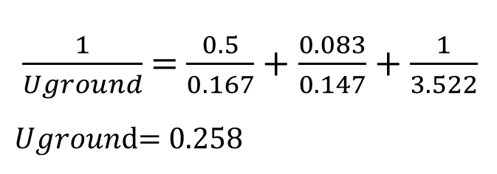
Calculation of heat load through ground
$$\frac{1}{Uground}={\left(\frac{L}{K}\right)}_{concrete}+{\left(\frac{L}{K}\right)}_{ tiles}+\frac{1}{h_{\begin{aligned}inside \\ air\end{aligned}}}$$
$\frac{1}{Uground}$ = $\frac{0.5}{0.167}+\frac{0.083}{0.147}+\frac{1}{3.522}$
$Ugroun$d= 0.258
Tiles
1’’
Concrete
5’’
soil
Qs= U * A* ∆T
= 0.258* 1276.5 * (83.3-75.2)
= 2667.63 BTU/hr

Slide 12
Calculation of people load
Q s (Btu/hr) = N (number of people) x SHG (Btu/hr) x CLF
Q l (Btu/hr) = N (number of people) x LHG (Btu/hr
Assumption: (10 hrs per day work)
CLF=0.17
THERMO SCIENE AND TERBO MACHINERY LAB
Assumption: Standing light work
SGH= 250 Btu/hr ,LGH=200 Btu/hr
N=30
Qs =30×250×0.17 = 1275 Btu/hr
Ql = 30×200 = 6000 Btu/hr
CAD-CAM LAB
Assumption: Moderately active work(office)
SGH= 250 Btu/hr ,LGH=200 Btu/hr
N=60
Qs =60×250×0.17 = 2550 Btu/hr
Ql = 60×200 = 12000 Btu/hr

Slide 13
Calculation of window-Door load
CAD-CAM LAB
CONDUCTION LOAD:
Q (Btu/hr) = U (Btu/hr-ft2 °F) x A (sq-ft) x CLTDc(°F)
Double gazed 6 mm thick | U | A | N |  | CLTD | CLTDc | Q
South Facing 32 windows | 0.53 | 8 | 32 |  | 13 | 14.1 | 1913.088
North Facing 26 windows | 0.53 | 8 | 26 |  | 13 | 14.1 | 1554.384
Door glass part(12 mm single gazed) | 0.76 | 28 | 1 |  | 13 | 6 | 127.68
RADIATION LOAD:
Q (Btu/hr) = A (sq-ft) x SC x SCL
SCL= CLF * Max SHGF
Reflective coated ligh 6mm thick | A | N | CLF |  | SC | Max SHGF | Q
South Facing 32 windows | 8 | 32 | 0.8 |  | 0.23 | 41 | 1931.264
North Facing 26 windows | 8 | 26 | 0.86 |  | 0.23 | 43 | 1769.1232
Door glass part(refective) | 28 | 1 | 0.86 |  | 0.3 | 43 | 310.632

Slide 14
THERMO SCIENE AND TERBO MACHINERY LAB
CONDUCTION LOAD:
Q (Btu/hr) = U (Btu/hr-ft2 °F) x A (sq-ft) x CLTDc(°F)
Double gazed 6 mm thick | U | A | N | CLTD | CLTDc | Q
South Facing 20 windows | 0.53 | 8 | 20 | 13 | 14.1 | 1195.6
North Facing 15 windows | 0.53 | 8 | 15 | 13 | 14.1 | 896.76
Door glass part(12 mm single gazed) | 0.76 | 28 | 1 | 13 | 6 | 127.68
RADIATION LOAD:
Q (Btu/hr) = A (sq-ft) x SC x SCL
SCL= CLF * Max SHGF
Heat Absorbing dark 6mm thick | A | N | CLF | SC | Max SHGF | Q
South Facing 20 windows | 8 | 20 | 0.8 | 0.45 | 41 | 2361.6
North Facing 15 windows | 8 | 15 | 0.86 | 0.45 | 43 | 1996.92
Door glass part(refective) | 28 | 1 | 0.86 | 0.3 | 43 | 310.632
 | A | N | U | Q
DOORS Aluminium Part | 28 | 1 | 2.08 | 58.24

Slide 15
Calculation of lighting load
Lighting load Qs(W)= Rule of thumb(W/sq feet)* Area(sq feet)* CLF
Assumption: CLF= 0.45(heavy weight simple furnishing, no carpet)
THERMO SCIENCE AND TERBO MACHINERY LAB
CAD-CAM LAB
Assumption: General office area( Rule of thumb= 2 W/ sq ft)
Assumption: Computer room( Rule of thumb= 3 W/ sq ft)
Qs = 2 × 897 × 0.45 = 3568.266 W
=12167.78 btu/hr
Qs = 3 × 1276.5 × 0.45 = 7616.8755W
=25973.54 btu/hr

Slide 16
Calculation of load though appliances
Q(Btu/hr) = 3.41 * W *(CLF)
W is the wattage of the equipment
CLF is the cooling load factor for the equipment
THERMO SCIENCE AND TERBO MACHINERY LAB
 | RATING(WATT) | NUMBER(N) | CLF | COOLING LOAD=3.4*N*RATING*CLF
Desktop System | 750 | 10 | 0.67 | 17085
Printer | 430 | 2 | 0.083 | 242.69
Modem | 10 | 3 | 1 | 102
Fan | 50 | 2 | 0.3 | 571.2
Refrigerator | 50 | 1 | 1 | 170
Tubular Heat Exchanger | 2100 | 1 | 0.1 | 714
Boiling Heat Transfer | 500 | 1 | 0.1 | 170
Heat Conduction Unit | 300 | 1 | 0.1 | 102
Cooling Tower + PC data | 2200 | 1 | 0.1 | 748
Refrigeration System | 600 | 1 | 0.1 | 204

Slide 17
CAD-CAM LAB
 | RATING(WATT) | NUMBER(N) | CLF | COOLING LOAD=3.4*N*RATING*CLF
Desktop System | 100 | 50 | 0.3 | 5100
Printer | 137 | 1 | 0.083 | 38.66
Modem | 10 | 2 | 1 | 68

Slide 18
Calculation of infiltration load
Q Sensible= 1.08 * CFM * ΔT
Q Latent= 4840 * CFM * ΔW
Assumption: Educational institute
CFM=5
THERMO SCIENCE AND TERBO MACHINERY LAB
CAD-CAM LAB
1. Sensible Heat | CFM | ΔT | No of ppl | Q
Educational Institute | 5 | 14.7 | 60 | 4762.8
2. Latent Heat | CFM | ΔW | No of ppl | Q
 | 5 | 0.0183 | 60 | 26571.6
1. Sensible Heat | CFM | n | ΔT | Q
Educational Institute | 5 | 30 | 14.7 | 2381.4
2. Latent Heat | CFM |  | ΔW | Q
 | 5 | 30 | 0.0183 | 13285.8

Slide 19
Calculation of total load
CAD-CAM LAB
SECTION | SHL(BTU/hr) | LHL(BTU/hr) | Total(BTU/hr)
WALLS | 18935.9029 |  | 18935.9029
DOORS AND WINDOWS | 7664.4112 |  | 7664.4112
Electrical Appliances | 30813.31037 |  | 30813.31037
People | 2550 | 12000 | 14550
infiltration | 4762.8 | 26571.6 | 31334.4
Total | 64726.42447 | 38571.6 | 103298.0245
Total(TR) |  |  | 8.655

Slide 20
Calculation of total load
THERMO SCIENCE AND TERBO MACHINERY LAB
SECTION | SHL(btU/hr) | LHL(btU/hr) | Total(btU/hr
WALLS | 16727.6619 |  | 16727.6619
DOORS AND WINDOWS | 6947.512 |  | 6947.512
Electrical Appliances | 36778.85781 |  | 36778.85781
People | 1275 | 6000 | 7275
infiltration | 2381.4 | 13285.8 | 15667.2
Total | 64110.43171 | 19285.8 | 83396.23171
Total (TR) |  |  | 6.98

Slide 21
FOR CAD-CAM LAB
Qs= 18.9 kW
Ql= 11.3 kW
SHF= 0.62
BPF= 0.1
Total mass flow rate = Qt /(hb - hg) = 1.6
From P-chart,
Va( Specific volume from ambient condition)= 0.9 m³/kg
mass flow rate of fresh air , mf =0.3*1.6 = 0.48 kg/s
Volume of air through ventilation = mf * 0.9 * 2118.8 = 915.32
CFM / person = 915.32/60 = 15.2
Assumed:
Coil temperature= 7 ˚C
Air entering the room at 15˚ C
30% of fresh air is used
From P chart,
Tc | 26.5˚ C
Tf | 7˚ C
he | 27 Kj/kg
hf | 25 kj/kg
hg | 32 kj/kg
hb | 47 kj/kg
hc | 62 kj/kg
ha | 98 kj/kg
Cooling coil capacity= 1.6 * (62-27) Kw
= 15.95 TR
Heating load = 1.6 * (32-27) kw
=2.2 TR

Slide 22
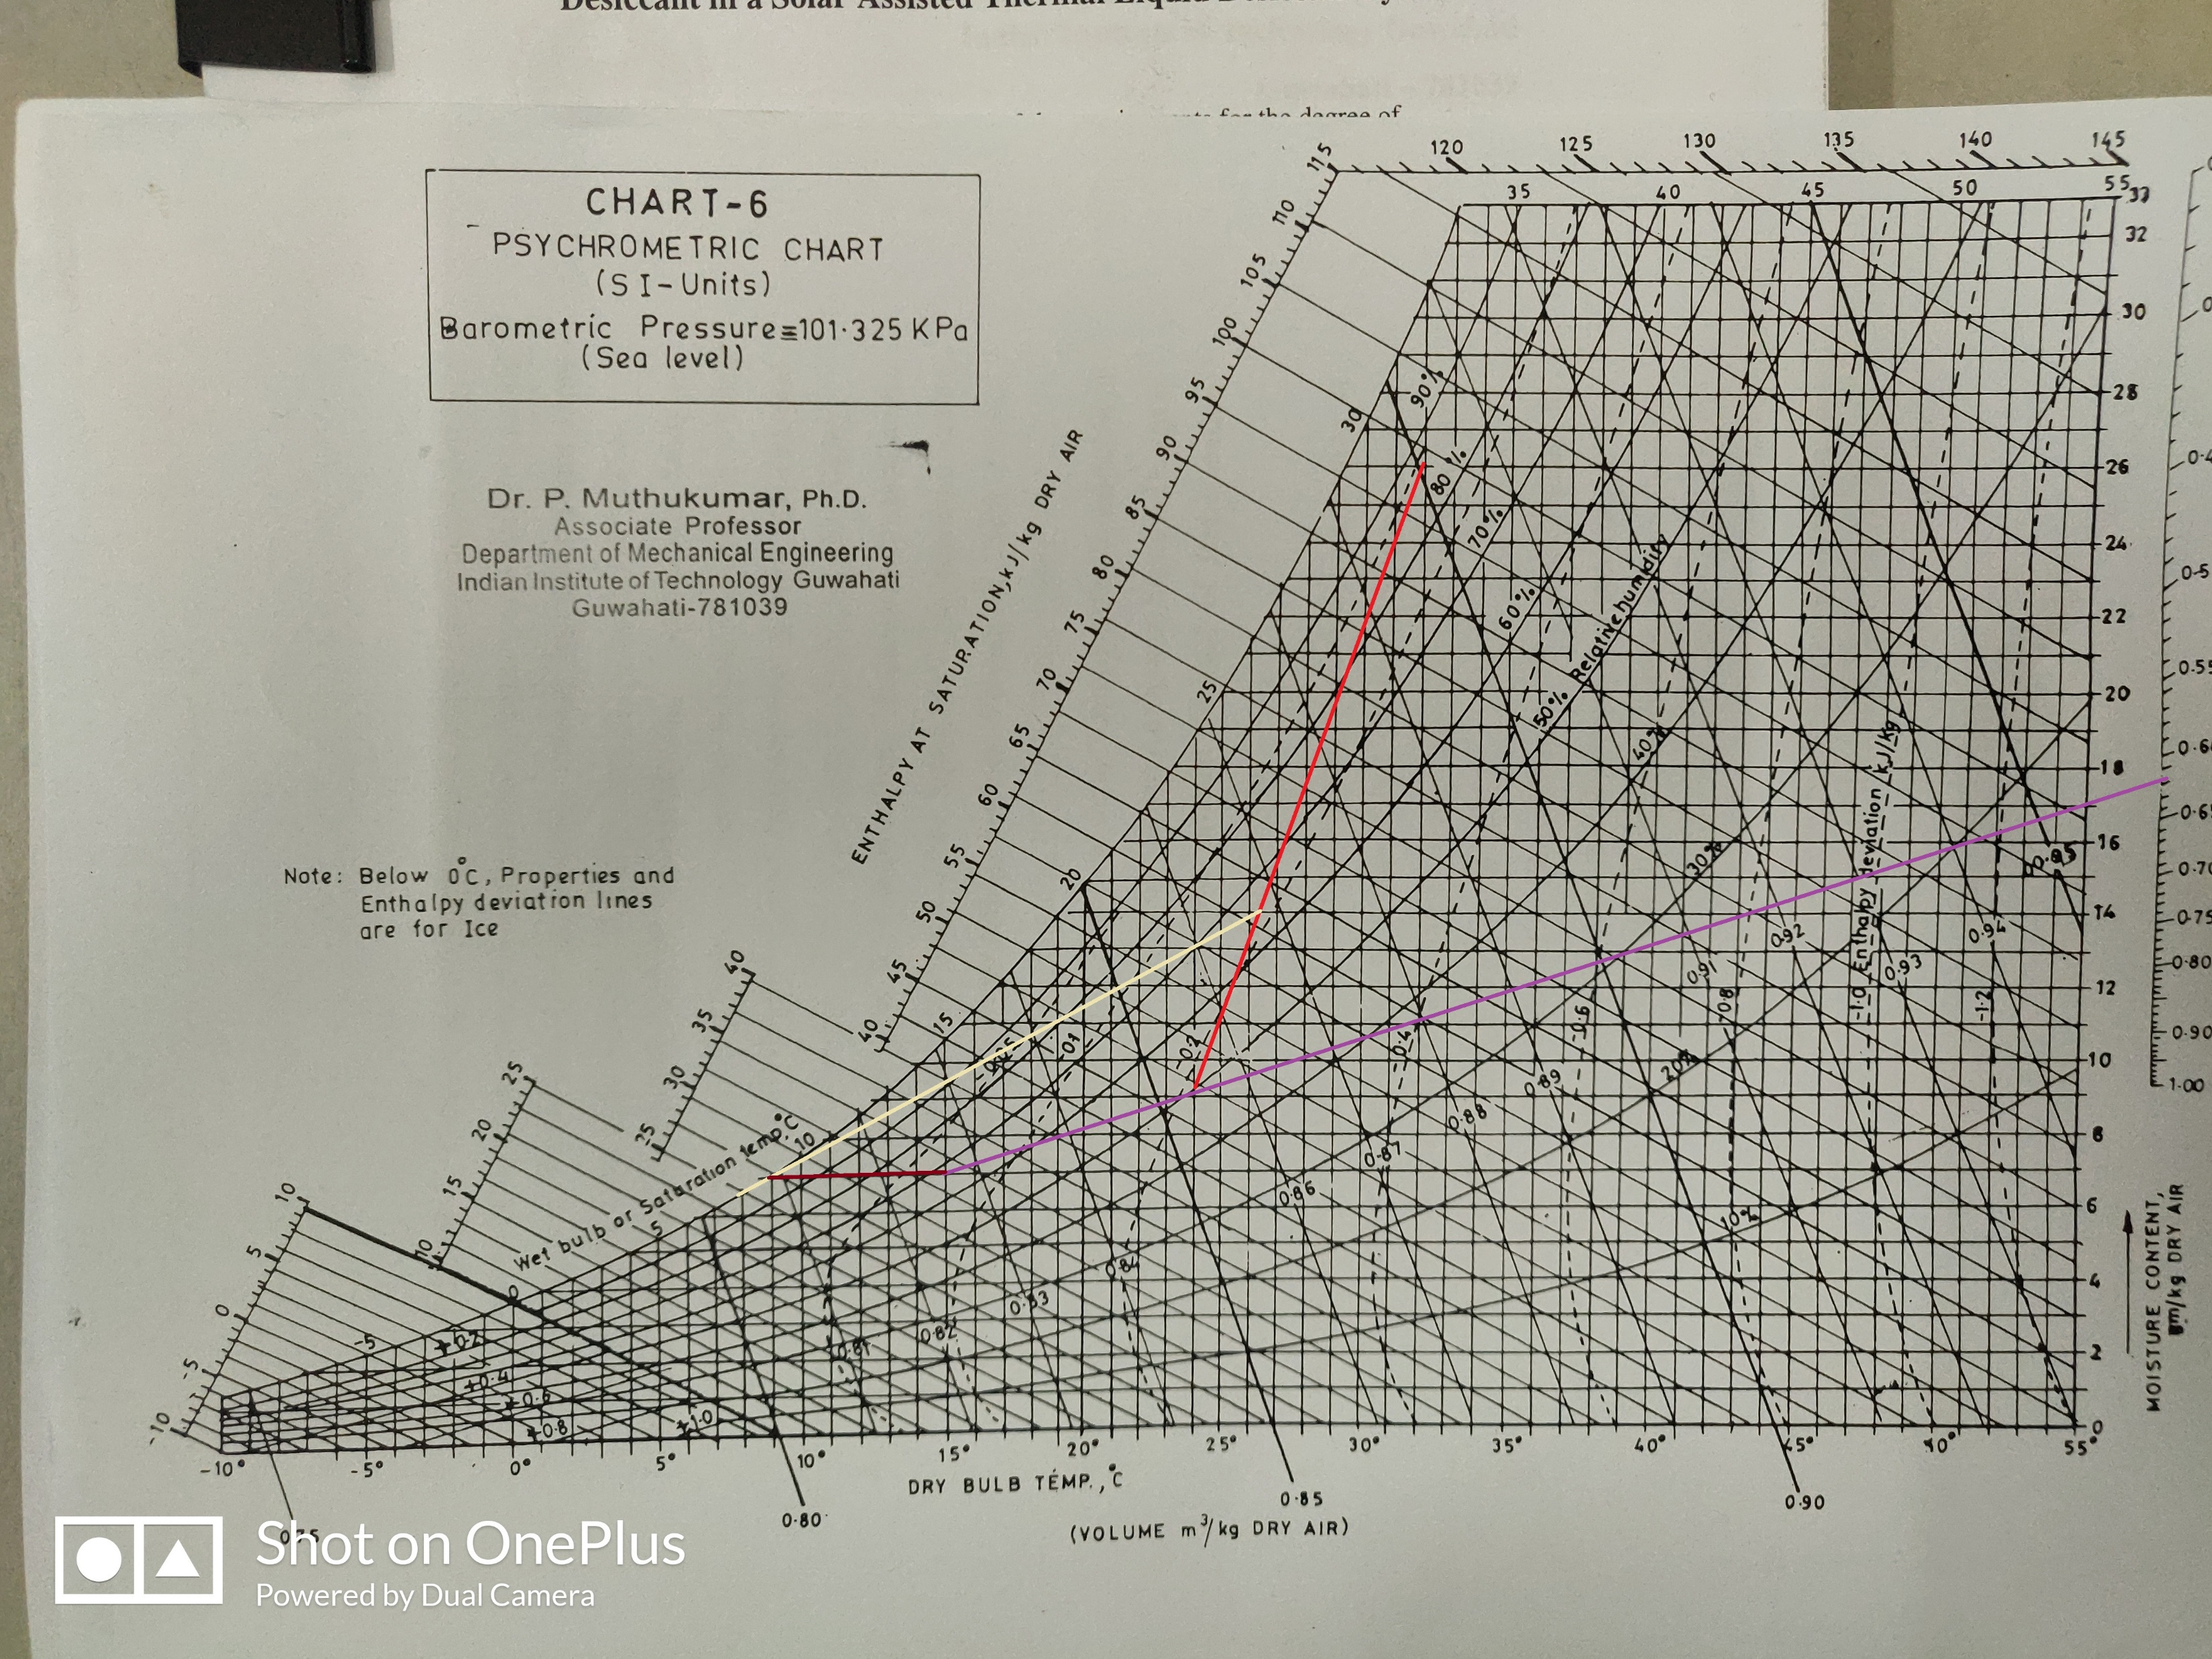

Slide 23
Calculation of ventilation load
Q Sensible= 1.08 * CFM * ΔT
Q Latent= 4840 * CFM * ΔW
1. Sensible Heat | CFM | ΔT | No of ppl |  | Q
Educational Institute | 5 | 23 | 60 | 1.08 | 7452
2. Latent Heat | CFM | ΔW | No of ppl |  | Q
 | 5 | 0.0183 | 60 | 4840 | 26571.6

Slide 24
Calculation of Total load with ventilation
SECTION | SHL(BTU/hr) | LHL(BTU/hr) | Total(BTU/hr)
WALLS | 18935.9029 |  | 18935.9029
DOORS AND WINDOWS | 7664.4112 |  | 7664.4112
Electrical Appliances | 24726.46037 |  | 24726.46037
People | 2550 | 12000 | 14550
infiltration | 4762.8 | 26571.6 | 31334.4
ventilation | 7452 | 26571.6 | 34023.6
Total | 66091.57447 | 65143.2 | 131234.7745
total (W) | 19381.69339 | 19103.57771 | 38485.27111
Total load= 10.99 TR

Slide 25
FOR THERMO-SCIENCE LAB
Qs= 18.8 kW
Ql= 5.6 kW
SHF= 0.77
BPF= 0.35
Total mass flow rate = Qt /(hb - hg) = 1.3
From P-chart,
Va( Specific volume from ambient condition)= 0.9 m³/kg
mass flow rate of fresh air , mf =0.2*1.3 = 0.26 kg/s
Volume of air through ventilation = mf * 0.9 * 2118.8 = 495.7
CFM / person = 495.7/30 = 16.5
Assumed:
Coil temperature= 7 ˚C
Air entering the room at 15˚ C
20% of fresh air is used
From P chart,
Tc | 25.5˚ C
Tf | 7˚ C
he | 35 Kj/kg
hf | 25 kj/kg
hg | 36 kj/kg
hb | 47 kj/kg
hc | 57 kj/kg
ha | 98 kj/kg
Cooling coil capacity= 1.3 * (57-35) Kw
= 8.15 TR
Heating load = 1.3 * (36-35) kw
= 0.37 TR

Slide 26
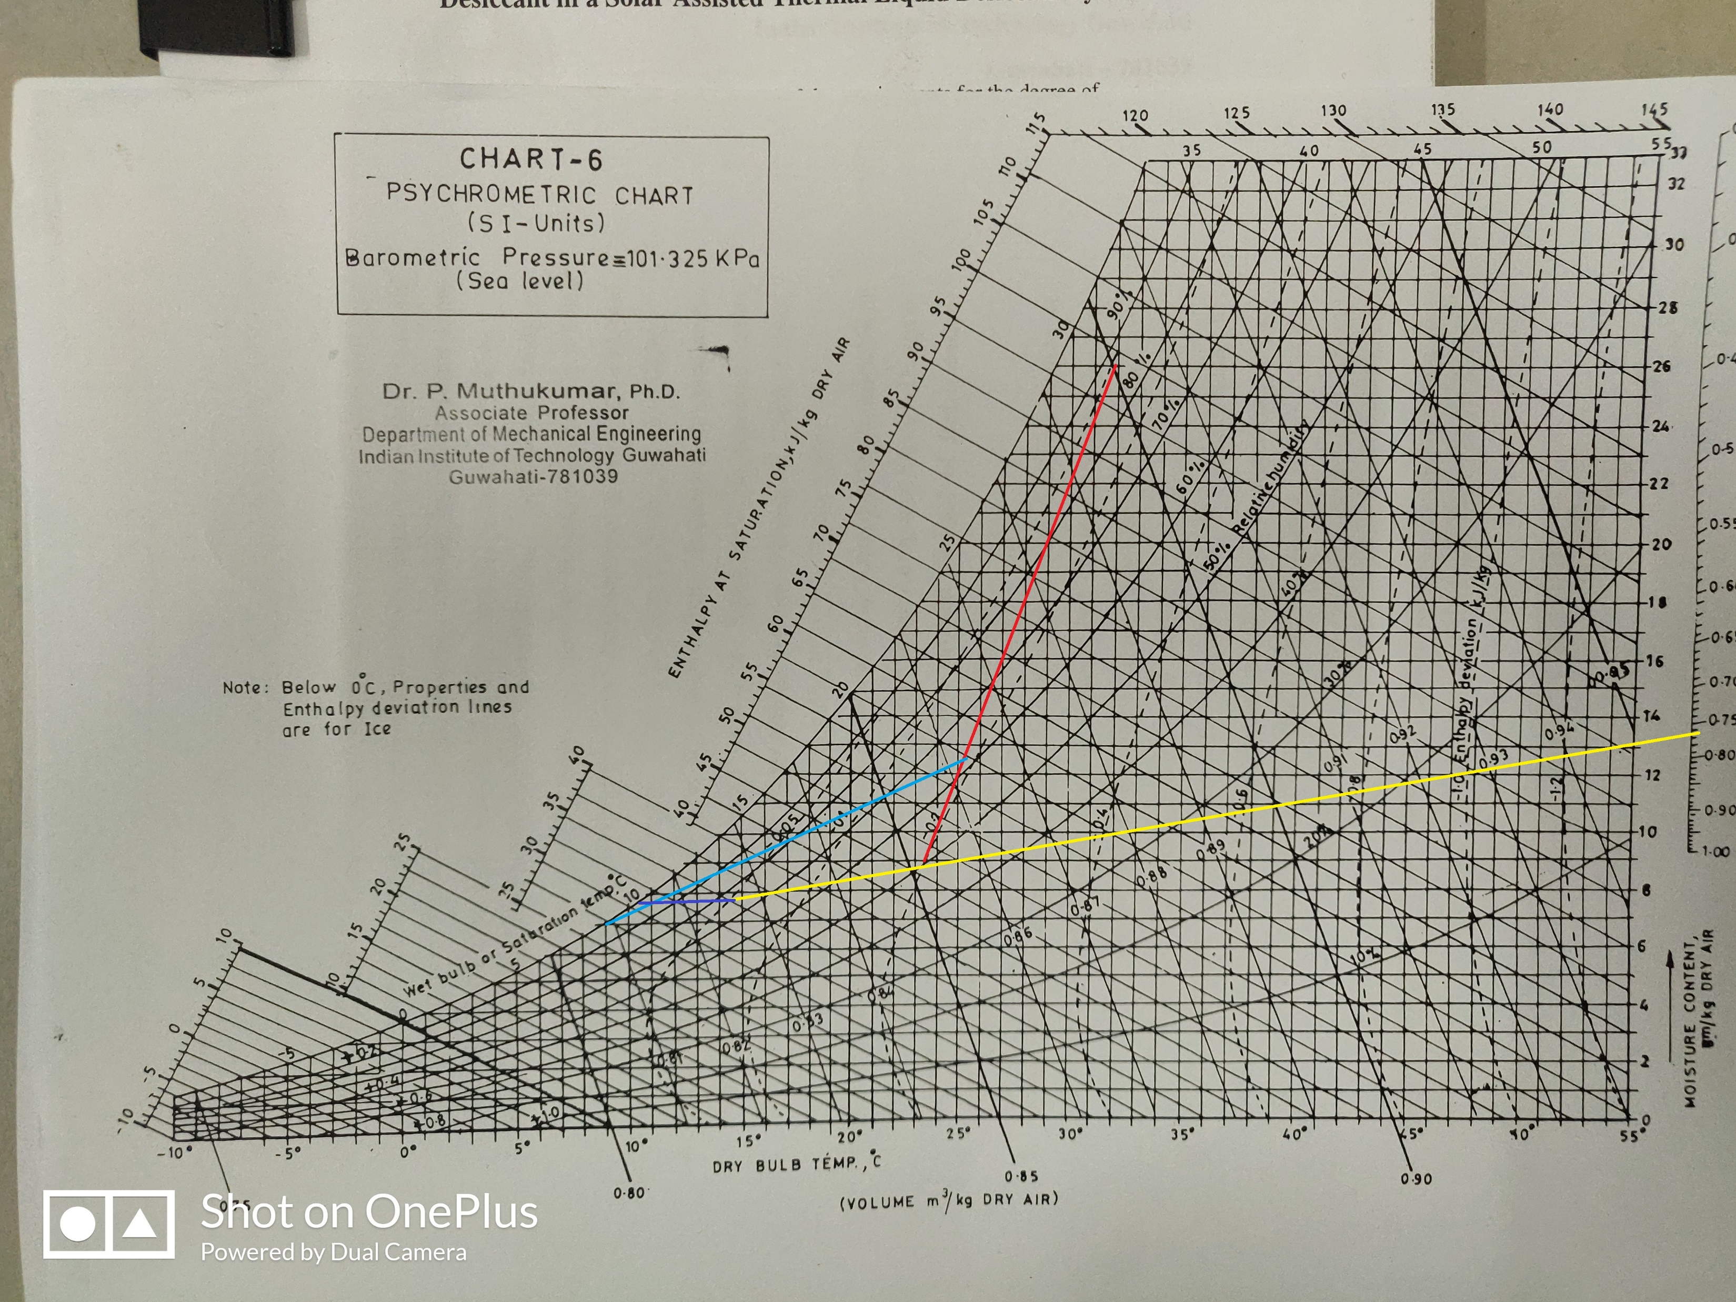

Slide 27
Calculation of ventilation load
Q Sensible= 1.08 * CFM * ΔT
Q Latent= 4840 * CFM * ΔW
1. Sensible Heat | CFM | ΔT | No of ppl | Q
Educational Institute | 5 | 18.5 | 30 | 2997
2. Latent Heat | CFM | ΔW | No of ppl | Q
 | 5 | 0.0183 | 30 | 13285.8

Slide 28
Calculation of total load
CAD-CAM LAB
SECTION | SHL(btU/hr) | LHL(btU/hr) | Total(btU/hr)
WALLS | 16727.6619 |  | 16727.6619
DOORS AND WINDOWS | 6947.512 |  | 6947.512
Electrical Appliances | 34060.06481 |  | 34060.06481
People | 1275 | 6000 | 7275
infiltration | 2381.4 | 13285.8 | 15667.2
ventilation | 2997 | 13285.8 | 16282.8
Total | 64388.63871 | 32571.6 | 96960.23871
Total load= 8.12 TR

Slide 29
References
ASHRAE Handbook, 2001
PPT Course ME621
Thermal Conductivities and Heat Transfer Coefficient
http://hyperphysics.phy-astr.gsu.edu/hbase/tables/thrcn.html
https://neutrium.net/heat-transfer/thermal-conductivity-of-common-materials/

Slide 30
Thank you

